Slide 1




MASTER THESIS PRESENTATION
Universidad Politécnica
de Madrid
Escuela Técnica Superior de
Ingenieros Informáticos
Master‘s degree in Data Science
Master´s Final Project
Serena Alderisi
Tutors: Pedro Larrañaga,
María Concepción Bielza
Madrid, October 2020

Slide 2

MACHINE LEARNING
APPLIED TO COVID-19

Slide 3

2.
SCREENING & DIAGNOSIS
6.
STRENGTHS & WEAKNESSES
STUDY OBJECTIVE
4.
DRUGS & VACCINEs
1.
INTRODUCTION
3.
CONTACT TRACING
5.
PREDICTION & FORECASTING
7.
CONCLUSION
MOST RECENT BREAKTHROUGHS THAT APPLY ML TO FIGHT COVID-19
Early diagnosis
ACHIEVEMENTS
and CHALLENGES
Related to ML tools
Development
Goals
Mobile apps
Critical cases
Case counts

Slide 4
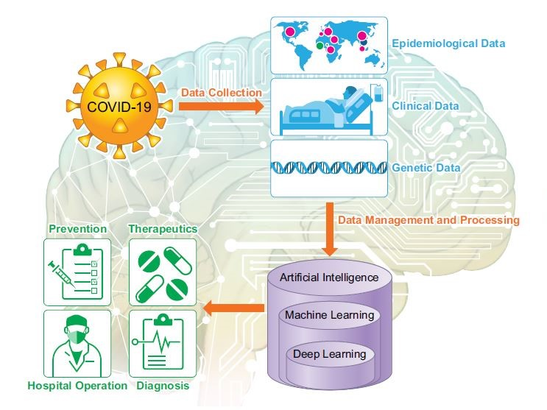
ROLE OF MACHINE LEARNING
Johns Hopkins University
GLOBAL CASES
45,126,200
GLOBAL DEATHS
1,182,368
AUGMENT MEDICAL and
ECONOMICAL SKILLS
Reduce clinicians efforts
Reduce clinicians contacts
Speed up processes
Reduce the spread
COV-FAMILY
MERS-COV
SARS-COV

Slide 5
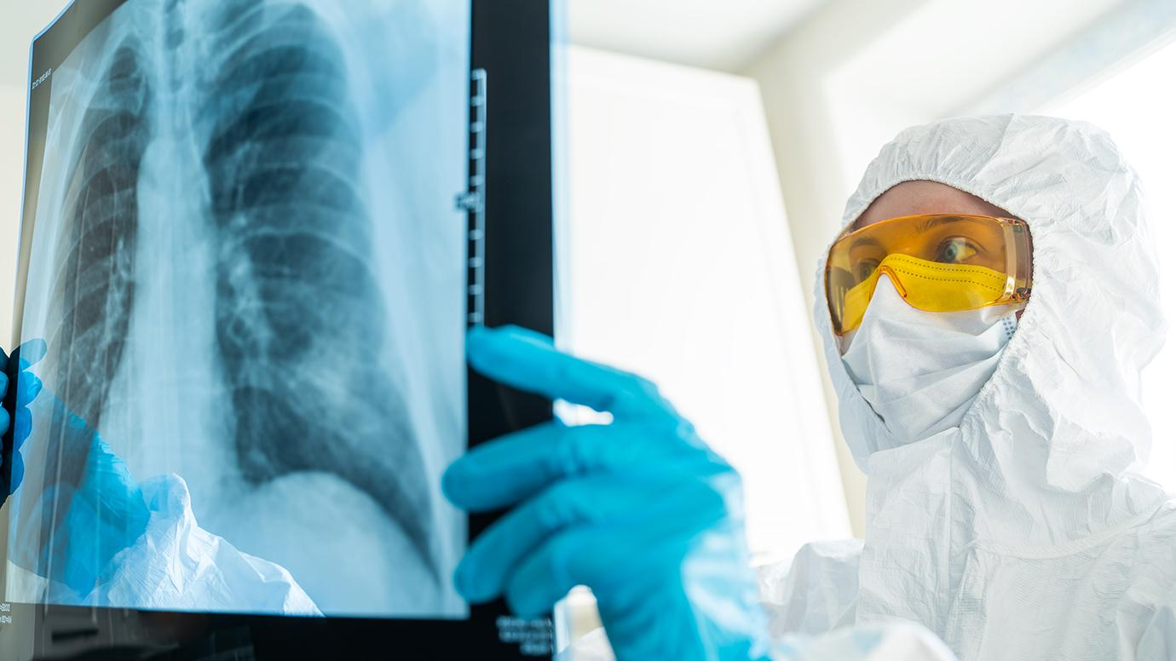
SCREENING
& DIAGNOSIS

Slide 6
RT-PCR
X-RAY IMAGES
The most reliable diagnostic tool
Useful in critical cases
3 - 5 days for the response
Expert mistakes
FN due to coinfection
To repeat more than once
Large amount of kits
Asymptomatic patients
Early stages of the disease
Different types of pneumonia
Wrong diagnosis by radiologist
EARLY, RAPID,
AS ACCURATE AS POSSIBLE
COVID-19 DETECTION
MACHINE LEARNING

Slide 7
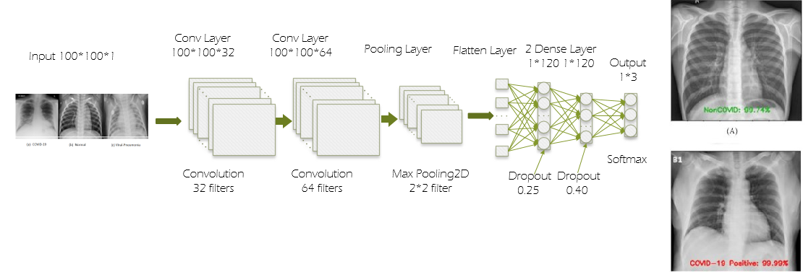
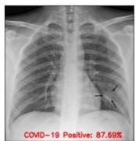
22 diagnostic models + 2 already commercially available ML tools
Viral pneumonia
COVID-19 pneumonia
Healthy person
COVID-19
Non COVID-19
Multi-class
CLASSIFICATION
Binary
CORD-19 (Research Challenge Kaggle - White House)
COVIDX (Open Source Project Github - Wong A., Wang L. 2020)
Private
DATA SOURCE
Public
Lack of data
Further improvements
Combination
DATASET
Single
DEEP CONVOLUTIONAL NEURAL NETWORK
CNN vs SVM, random forest, KNN, MLP, decision trees
COVID-19 pneumonia - other pneumonia
Ahammed et al., 2020
Accuracy 94.03%, F1-score 94.03%, sensitivity 94.03%, specificity 97.01%

Slide 8
GENERAL IDEAS
CNN for feature extraction + supervised ML for classification
Mei et al. 2020
Arkadani et al. 2020
CT images + clinical info pre-trained CNN + MLP
AUC 92% vs 84%
10 CNNs(ResnNet101)
accuracy 99.5% vs 86%
vs expert radiologists
CNN1 feature extraction
knowledge acquired as input for
CNN2 for classification
Nour et al. 2020
Transfer Learning
CNN from scratch + SVM for classification + Bayesian opt. for hyperparameters
99% accuracy
multi-view representation learning correlation based FS
Feature Selection
lung region segmentation
pyramid network
Ucar et al. 2020
Abraham et al. 2020
multi - CNN for FE + Bayesian net classification (Hill Climbing and K2 score)
97% accuracy
CNN + Bayesian opt.
+ data augmentation
Other Approaches
Detailed tables at the last pages

Slide 9
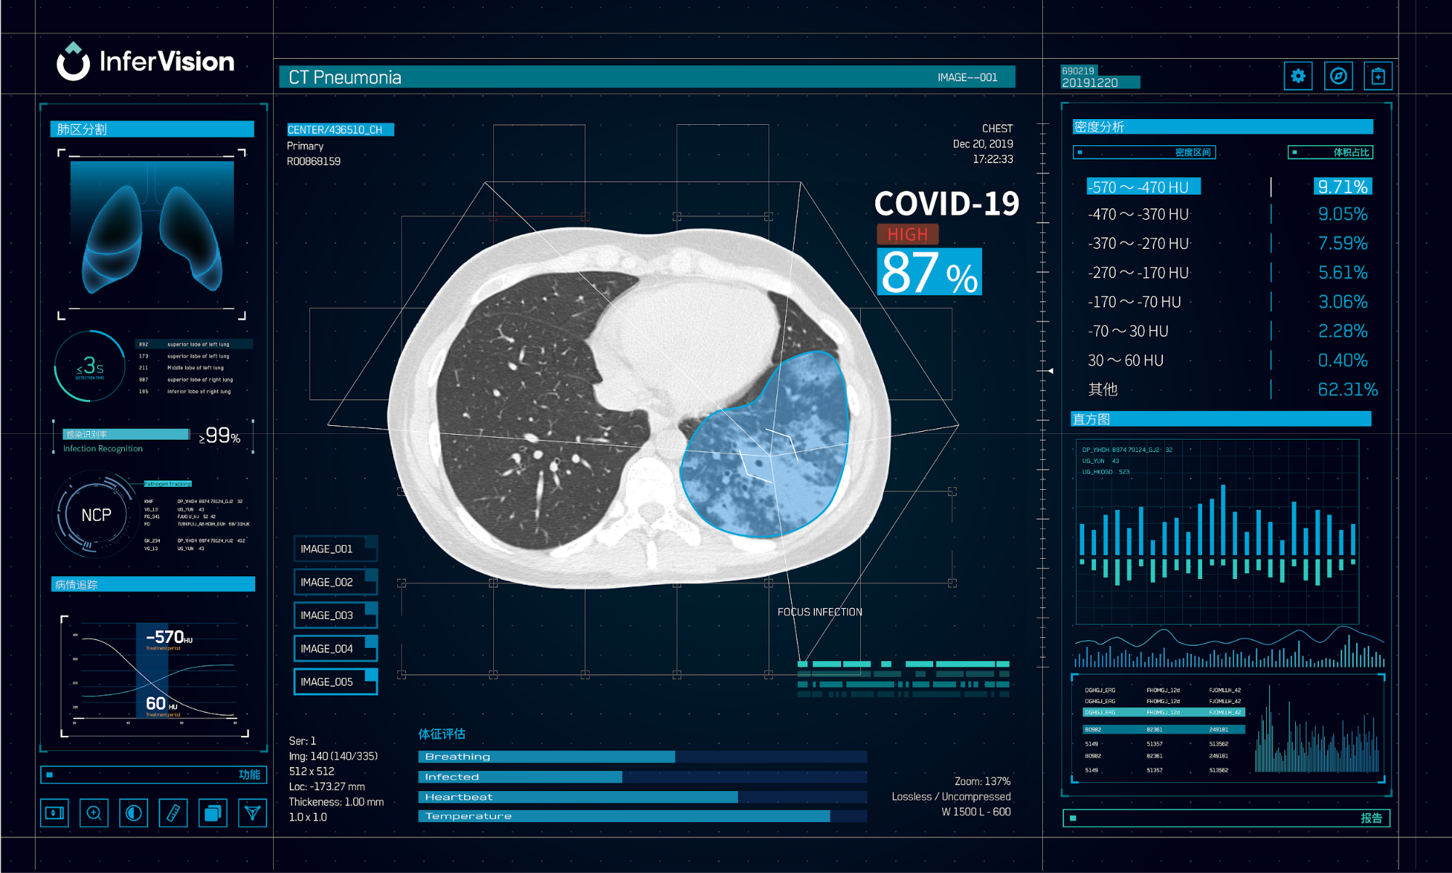
ON THE MARKET
1. INFERVISION
Clinical conditions complete view (it alarms in 2 minutes)
Used in February 2020 in China Hospitals
2. ALIBABA GROUP
96% accuracy in
20’’ diagnosis vs 5-10’
More than 100 hospitals
Different type of pneumonia
Read CT pneumonia
Proper equipments
Support radiologist activity
Remote places with
shortage of radiologist
Optimize hospitals work
Further data to be implemented in real time diagnosis

Slide 10
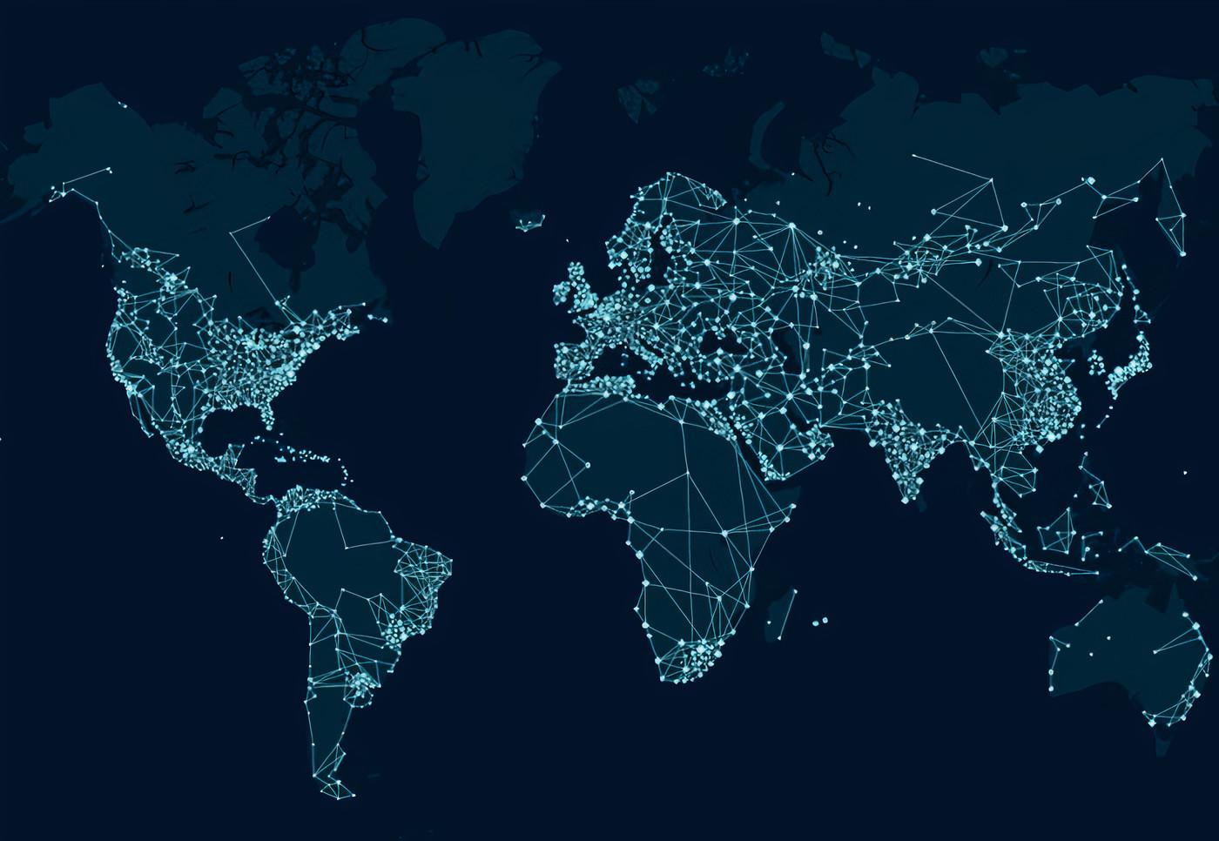

CONTACT TRACING

Slide 11
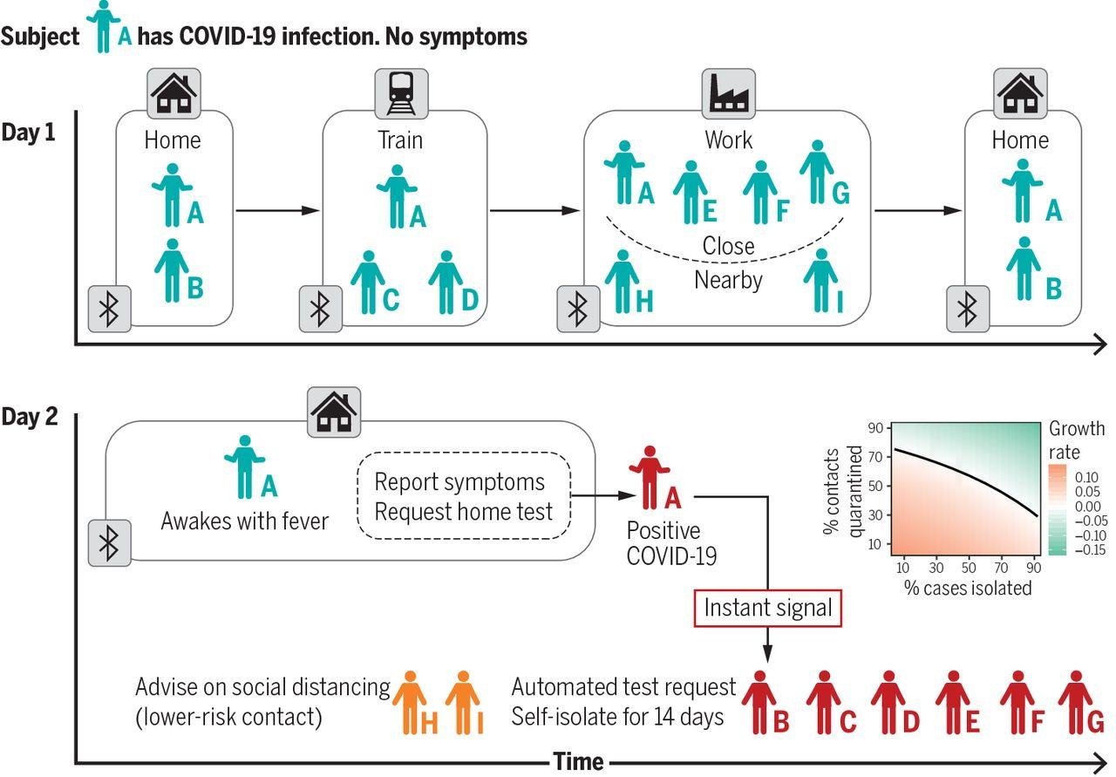
BREAK THE TRANSMISSION CHAIN
Radar COVID - Spain
Immuni - Italy
NHS COVID + Symptoms Tracker app - UK
Proximity events
Istant, anonymous notification
Contact tracing
+ symptoms
Probability of Infection
McLachlan et al. 2020
Bayesian network
Mackey et al. 2020
Biterm topic model
Social Media
Text mining to collect experience in tweets
Ferretti et al. 2020
More data available
More awareness
Avoid the spread
Privacy concerns
VULNERABLE
CLOSE CONTACTS
ML

Slide 12
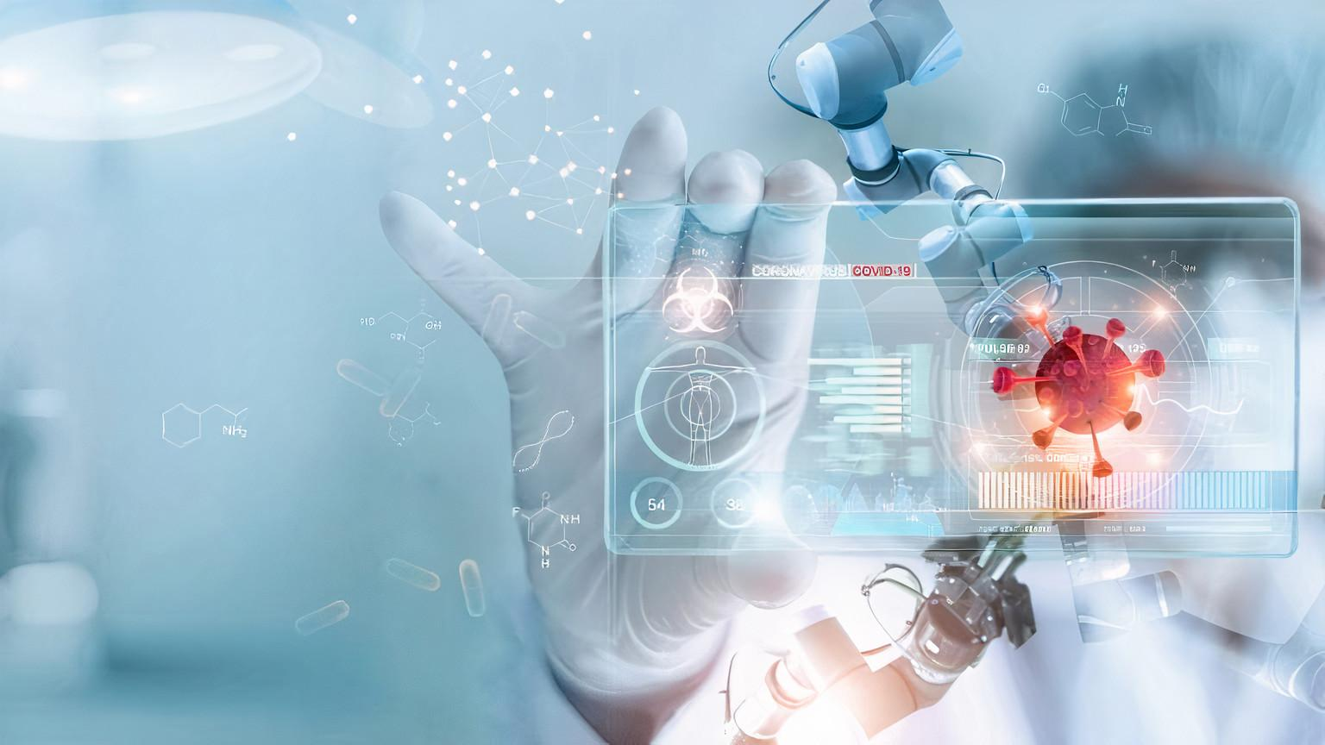
DRUGS & VACCINES

Slide 13
DRUGS
Already existing on the market
VACCINES
Identify specific biomedical characteristic
ML
SPEED UP THE PROCESS
SAVE TIME AND RESOURCES
IMMUNE-RESPONSE
by likelihood
reverse vaccinology
Proteins Rank
Ong et al. 2020
SVM, KNN, random forest
for the strongest candidates
EVQLV
hundred millions antibodies
of COVID19 cells
raw DNA sequences
Genes Classification
Randhawa et al. 2020
SVM, KNN
5 years
Half billion $ saved
Lower risk
Beck et al. 2020
specific DCNN
Old Drugs
to act on viral proteins
treatments for HIV

Slide 14

PREDICTION & FORECASTING

Slide 15
CASE SEVERITY
AUC 97%
sensitivity 100%
clinical/laboratory features
Sun et al. 2020
SVM
ML
Yan et al. 2020 XGBoost
biomarkers
To predict mortality after 10 days
AUC 99%
sensitivity 100%
blood test
Wu et al. 2020
random forest
CASE COUNTS
Canada transmission trends 93% accuracy
key trend features
Chimmula et al. 2020
long-short memory network
Better triage
Avoid ICU stress
Better planning strategies
Less-invasive measures
social media
Daily case counts
up to 14 days
Shen et al. 2020
random forest
Likelihood to
have COVID-19
Symptom Tracker app
Menni et al. 2020 logistic regression

Slide 16

STRENGThS & WEAKNESSES

Slide 17
SWOT ANALYSIS
S W
S W
Early detection for faster treatments
Radiologist activity
Support
Avoid contacts
Need heavy computational resources
Need manual supervision
Lack of data
Need technological awareness
Need the whole population
No communication delays
Quick alert
Robust COVID-19
prevention
SCREENING AND DIAGNOSIS
O T
O T
CONTACT TRACING
Discriminate pneumonia types
Confirmation to swab test results
Riluttances by doctors
Not 100% reliable
Private info loss
Sharing worldwide mobile data
More accurate case counts predictions
Malfunctioning
Distrust for
privacy issue
Security threats
S W
S W
Money/ Resources saving
Speeding up discovery
Fatal results in real world
Need close AI and medical expert cooperation
Early critical symptoms
identification
Predict case counts
Predict contagion trends
Lack of data
Rely on already identifIed
case patterns
PREDICTION AND FORECAST
DRUGS AND VACCINES
O T
O T
Discovering without
harming living society
Predict reusability of
old drugs
Privacy breach
Loss of lives
Better allocation of
medical resources
Better strategies
planning
Unnecessary panic
situation
False negative prediction
Privacy concerns

Slide 18

CONCLUSION

Slide 19
FUTURE STUDIES
1. ICUs Data Stream
Predict high peaks
and trends
7. Data
Scientists
2. Symptoms Clustering
Predict responses after treatments
3. Europe/Worldwide Contact Tracing
Integrate different countries info
Messy datasets
Scientific biomedical terms
4. Virus Loads
Close contacts +
dangerous cases
5. Post-Infection
Patients monitoring
progression
6. Seasonality
In contagion development

Slide 20

ThANK YOU!
THANK YOU!
Serena Alderisi
Serena Alderisi

